Slide 1

A PROJECT PRESENTATION ON
ONLINE NEWS APPLICATION
Developed By: Guided By:
Prerna Pandey (2005250130040) Mr. Deepak Kumar
Pallavi Singh (2005250130034)
Aryan Srivastav (2005250130015)
Department of Information Technology
Buddha Institute of Technology
GIDA, Gorakhpur

Slide 2

Table Of Contents
Introduction
The Power of Real-time News
User Experience and Interface
The Features
Challenges Faced
Solutions
Conclusion
Future of Global Wire

Slide 3

Introduction
Android News Application is a mobile news system which provides lightning-fast news and runs under Android platform.
With powerful and responsive panel, the user can personalize their news,, manage credentials, and many more.
This app uses Application Program Interface (API) to fetch latest news from all over the world.

Slide 4



The Power of Real-time News
Real-time news empowers users to make informed decisions and react swiftly to unfolding events.
The system delves into the behind-the-scenes process of news aggregation through API integration.
Its dynamic API technology enables us to provide up-to-the-minute news from diverse sources across the globe.
Real-time news transcends geographical boundaries, giving users access to events from around the world.
During emergencies, real-time news becomes indispensable for disseminating critical information to the public, coordinating relief efforts, and keeping communities safe and informed.

Slide 5

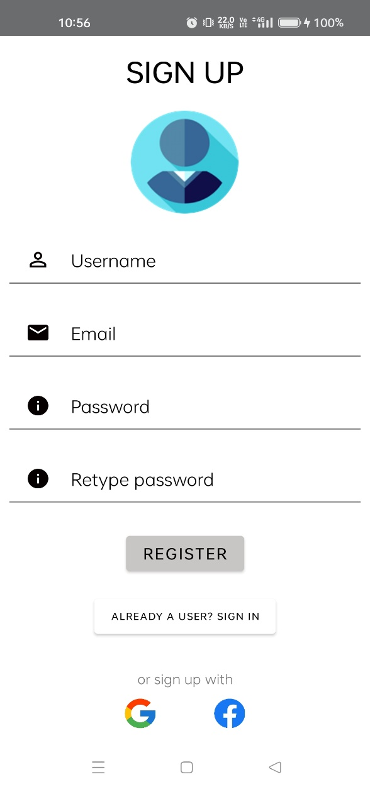
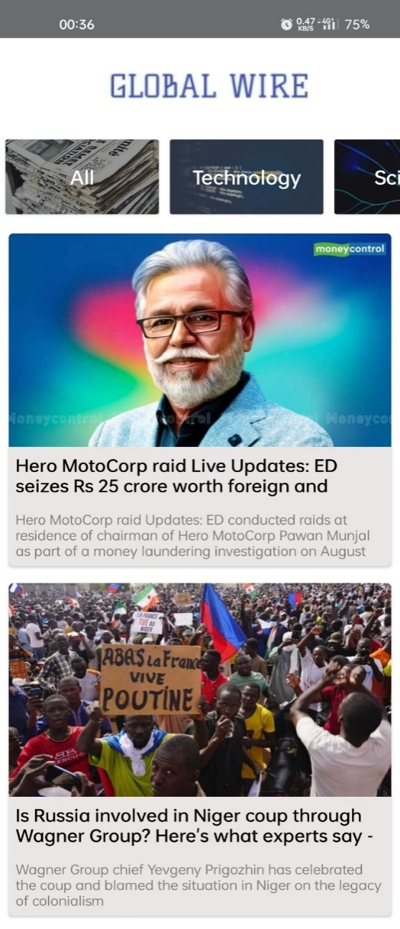
User Experience and Interface
The app organizes news content in a logical and structured manner, making it easy for users to explore different categories and topics.
Global Wire caters to individual preferences by offering personalized news feeds. Users can customize their content based on their interests, ensuring a tailored news experience.
Global Wire prioritizes a smooth reading experience, optimizing article layout and font size for readability on various devices.
The app prioritizes a frictionless sign-up process, enabling users to quickly create accounts and start exploring news content without unnecessary delays.

Slide 6

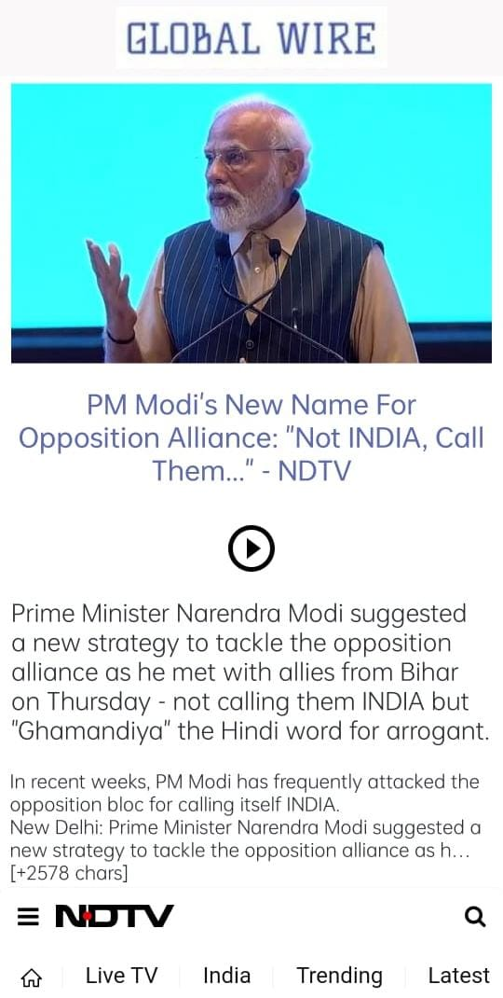
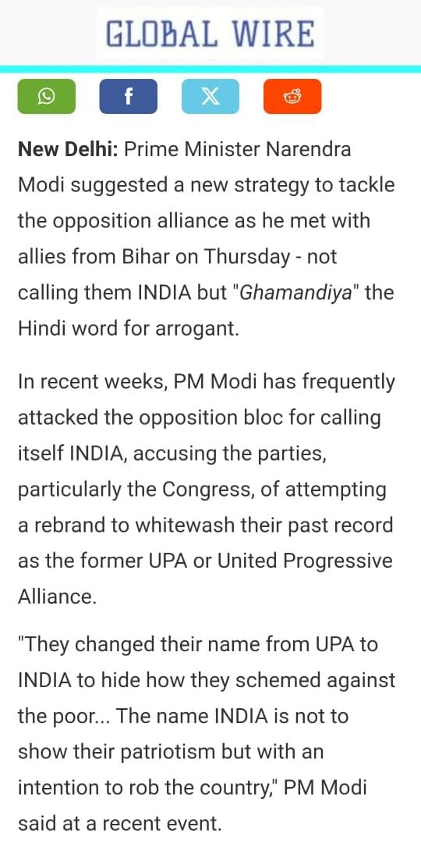
The Features
Global Wire delivers instant and real-time news updates from reputable sources, ensuring users stay informed about the latest events as they happen.
Users receive timely notifications for critical breaking news and significant events, keeping them abreast of unfolding situations.
Global Wire organizes news into various categories and topics, making it simple for users to explore diverse subjects of interest.
News articles on Global Wire may include multimedia elements, such as images and videos, enhancing the overall reading experience.
Users can open the original source URL of a news article in their device’s web browser for a comprehensive reading experience.

Slide 7

Challenges
In regions with slow internet speeds or limited connectivity, the app's performance may be affected.
Integrating with various APIs can lead to occasional technical issues, such as data syncing problems, slow loading times, or service outages.
As an app relying on APIs, user data may be shared with third-party providers.

Slide 8

Solutions
Solution 1
Optimize the app's data usage to minimize bandwidth requirements, especially in regions with limited connectivity.
Solution 2
Establish a dedicated technical support team to promptly address and resolve any API integration issues.
Solution 3
Implement a thorough vetting process for news sources to ensure they are credible and reputable.

Slide 9

Future Scope
Implementing advanced AI algorithms can further personalize news recommendations, analyzing user behavior to suggest even more relevant content.
Expand coverage to include hyper-local news for users to stay informed about events and developments in their immediate vicinity.
Utilize data analytics to identify emerging trends and analyze user engagement patterns, enabling data-driven improvements to the app.

Slide 10

Conclusion
The proposed development of the news app provides an opportunity to resolve the challenges users face in accessing relevant and reliable news content. By leveraging the power of modern app development technologies and adhering to industry best practices, we aim to create an intuitive and feature-rich application that caters to the diverse information needs of users. This project offers an excellent opportunity to apply the concepts learned in the academic time to solve real-world problems and enhance the news consumption experience for Android users.

Slide 11

Questions?

